Slide 1
MSE – 803 – Data Analytics
Week 2 – Activity 1
Beijin Multi-site Air Quality
Andre Benedetti
17/04/2026

Slide 2
Beijin Multi-site Air Quality – Data Colletion
No of stations: | 12
Period: | From 01/03/2013 to 28/02/2017
Samples: | 420,768
Six Pollutants measured: | Particullate Matter 2.5; Particullate Matter 10; SO2; NO2; CO; 03
Six Conditions measured | Temperature, Pressure, Dew Point Temperature, Volume of Rain, Direction of wind, and Wind Speed
Replacement data: | Average for numerical values and mode (most frequent value) for the direction of wind.

Slide 3
Beijin Multi-site Air Quality – General data
 | Dasta | Description | Unit | mean | median | std | min | max
Pollutants | PM2.5 | Fine Particulate Matter | micrograms per cubic meter | 79.79 | 57.00 | 79.98 | 2.00 | 999.00
 | PM10 | Inhalable Particulate Matter | micrograms per cubic meter | 104.60 | 84.00 | 91.07 | 2.00 | 999.00
 | SO2 | Sulfur Dioxide | micrograms per cubic meter | 15.83 | 8.00 | 21.42 | 0.29 | 500.00
 | NO2 | Nitrogen Dioxide | micrograms per cubic meter | 50.64 | 45.00 | 34.62 | 1.03 | 290.00
 | CO | Carbon Monoxide | milligrams per cubic meter | 1,230.77 | 900.00 | 1,131.28 | 100.00 | 10,000.00
 | O3 | Ozone | micrograms per cubic meter | 57.37 | 47.00 | 55.76 | 0.21 | 1,071.00
Meteorological | TEMP | Temperature | degrees Celsius | 13.54 | 14.50 | 11.43 | - 19.90 | 41.60
 | PRES | Pressure | hectopascals | 1,010.75 | 1,010.40 | 10.47 | 982.40 | 1,042.80
 | DEWP | Dew Point Temperature | degrees Celsius | 2.49 | 3.00 | 13.79 | - 43.40 | 29.10
 | RAIN | Precipitation | millimeters | 0.06 | - | 0.82 | - | 72.50
 | WSPM | Wind Speed | meters per second | 1.73 | 1.40 | 1.25 | - | 13.20

Slide 4
Beijin Multi-site Air Quality – Pollutants by station
station | PM2.5 | PM10 | SO2 | NO2 | CO | O3
Aotizhongxin | 82.69 | 109.95 | 17.33 | 59.05 | 1,261.32 | 56.40
Changping | 71.29 | 94.82 | 14.97 | 44.30 | 1,155.70 | 57.93
Dingling | 66.30 | 84.13 | 11.83 | 28.40 | 923.59 | 68.16
Dongsi | 86.06 | 110.25 | 18.48 | 53.56 | 1,321.02 | 57.21
Guanyuan | 82.88 | 108.97 | 17.57 | 57.77 | 1,269.27 | 55.85
Gucheng | 83.78 | 118.71 | 15.37 | 55.77 | 1,320.25 | 57.69
Huairou | 69.90 | 91.77 | 12.23 | 33.35 | 1,031.00 | 59.74
Nongzhanguan | 84.75 | 108.94 | 18.65 | 57.95 | 1,321.13 | 58.52
Shunyi | 79.50 | 98.83 | 13.66 | 44.17 | 1,189.78 | 55.29
Tiantan | 82.12 | 106.33 | 14.41 | 53.11 | 1,296.13 | 56.02
Wanliu | 83.34 | 110.42 | 18.33 | 64.81 | 1,314.78 | 49.38
Wanshouxigong | 84.92 | 112.12 | 17.12 | 55.42 | 1,365.23 | 56.27

Slide 5
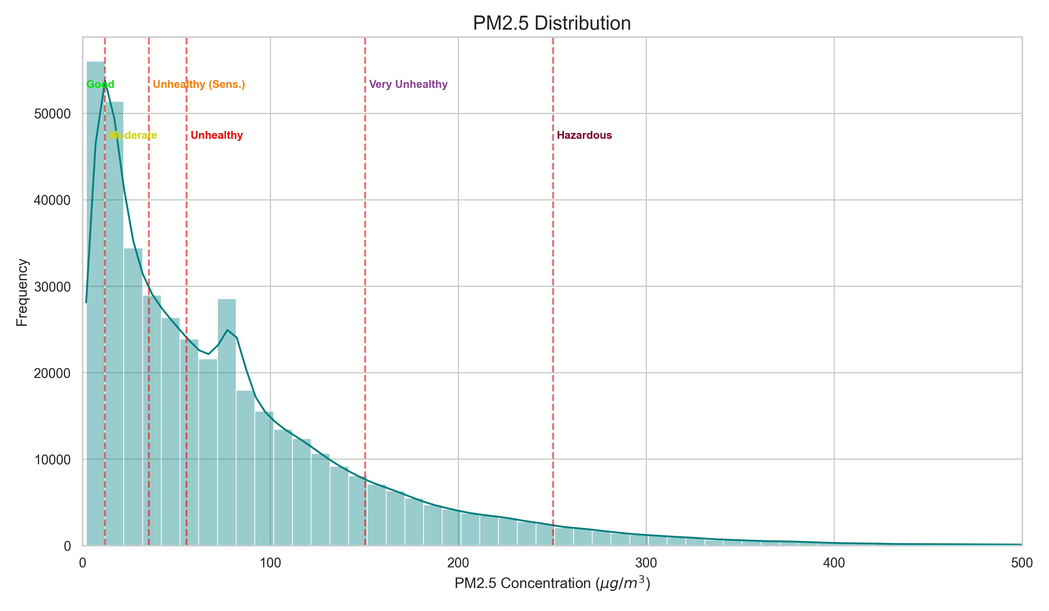
Beijin Multi-site Air Quality – PM2.5 concentration
*Air Quality Index (AQI) per World Health Organization classification

Slide 6
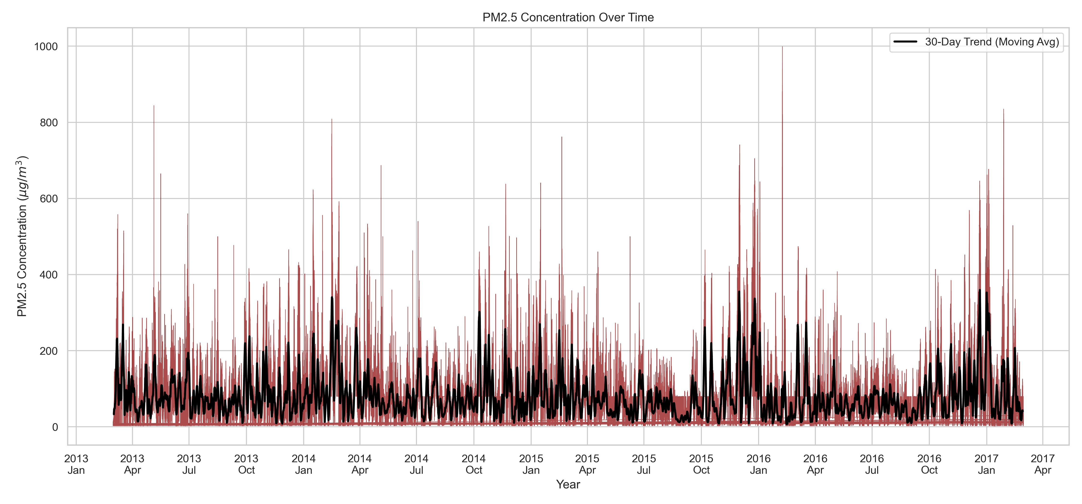
Beijin Multi-site Air Quality – PM2.5 concentration

Slide 7
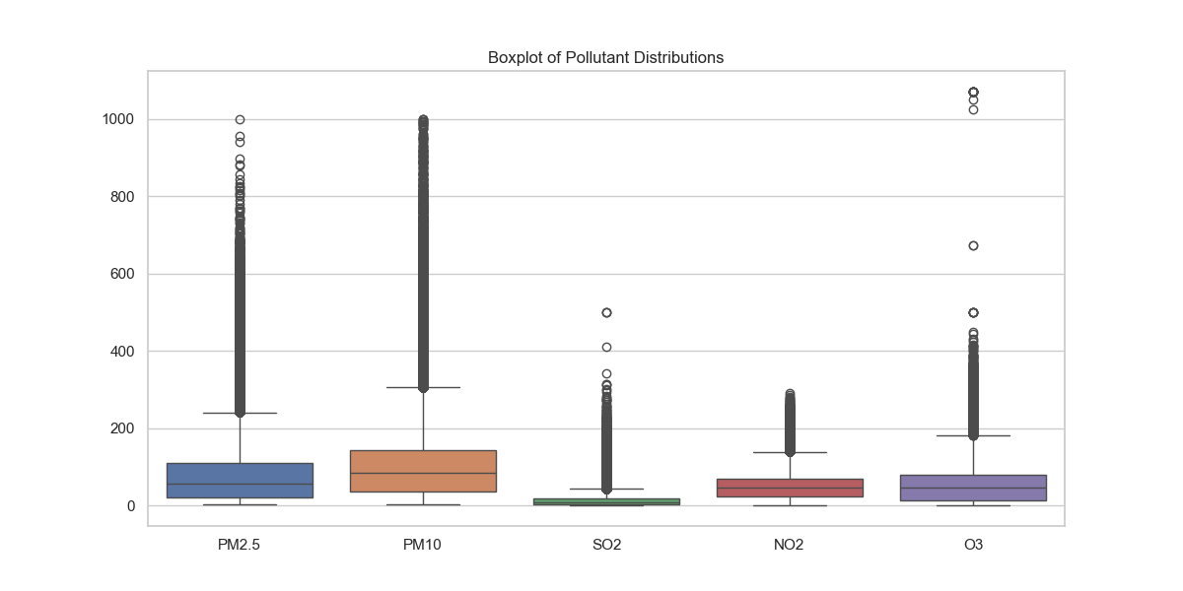
Beijin Multi-site Air Quality – Concentratrion of Pollutants

Slide 8
Beijin Multi-site Air Quality – PM2.5 p-Value
DEWP | 0.113499
PRES | 0.018357
hour | 0.011606
month | 0.010341
day | 0.003391
RAIN | -0.01416
No | -0.02335
year | -0.02561
TEMP | -0.12972
WSPM | -0.26902
Wind speed is the is the primary natural mechanism for dispersing pollutants in this area.

Slide 9
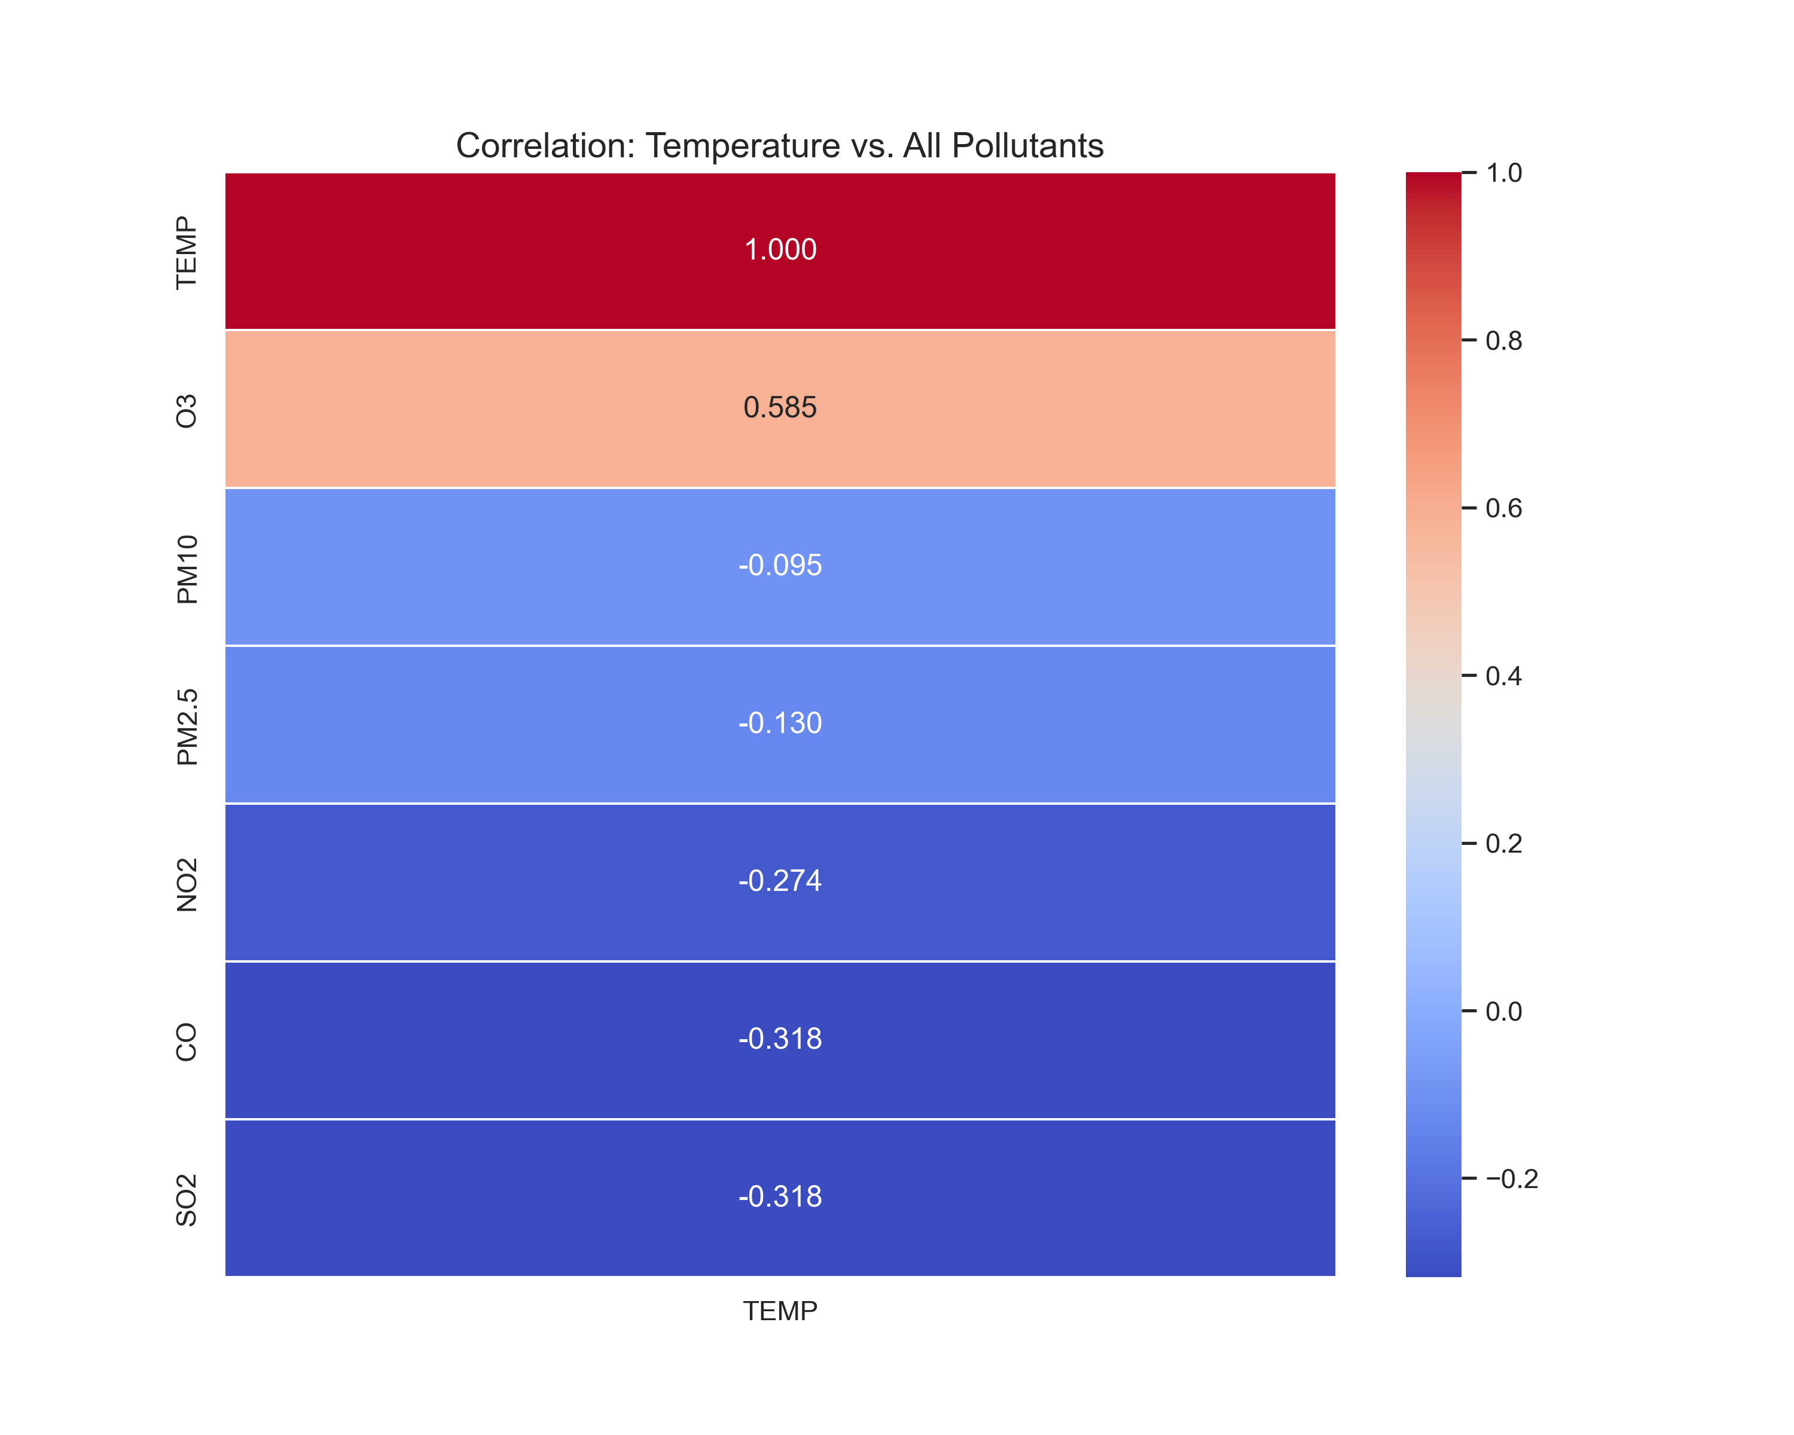
Beijin Multi-site Air Quality – Temperature x Polluants
As Temperature increases, there is a Strong correlation with the increase of O3.
As the temperatures decrease, we see a correlation of an increase of all the others polluants.

